Slide 1
Salary Management System Database

Slide 2
Project Description
The salary system allows the company management to manage and calculates the pay slip of their employees.
With this ERD or Database Design of Payroll System, management can calculate the employees' pay slip that includes their allowances and deductions.
It also includes an Attendance Table which will be used in computing the total days of present, days of absences, minutes of tardy/undertime of each employee between the cut-off days.
Salary Management System has all the capabilities required to minimize the usage of paper and cash in its operations. The use of paper has undoubtedly decreased as more people use computers, laptops, and mobile devices.

Slide 3
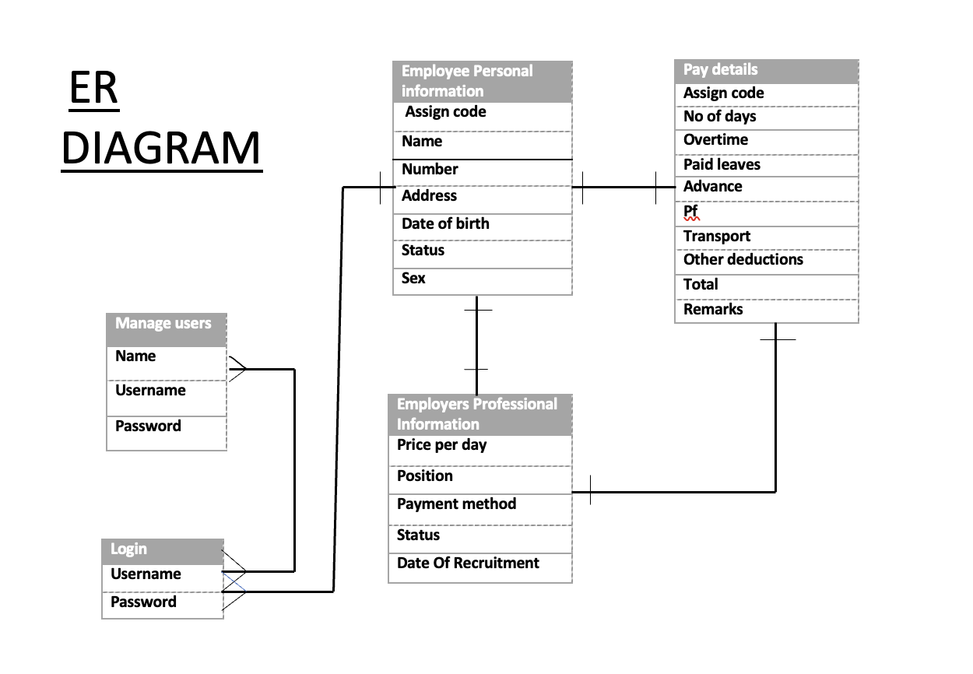
Database ER diagram & Data Dictionary
Field Name: The name of the field/column in the table
Data Type: The data type of the field/column
Length: The maximum length of the field/column
Nullable: Indicates if the field/column can be left empty or not (Yes/No)
Description: A brief description of the field/column's purpose in the table

Slide 4
Database Design Process
Identify the entities: Start by identifying the main entities.
Determine the relationships: Determine the relationships between the entities.
Normalize the data: Normalize the data to reduce redundancy and improve data integrity.
Implement the database: Implement the database by creating tables, defining relationships, and setting up constraints to ensure data integrity.

Slide 5
Database Structure
A salary management database structure includes tables such as employee, department, and salary, each with specific columns representing attributes such as name, job title, salary, and department ID.
The primary key for the employee table would be the employee ID, and the department table would have a primary key of department ID.
A foreign key would link the employee and department tables.
Indexes would be created on columns frequently searched, such as employee name or department name.
Constraints would ensure data consistency and accuracy, such as ensuring that only valid department IDs are entered.
The structure would allow for efficient data retrieval and management of employee salary information.
Salary Management Database
Employee Details
Payroll Details
Login

Slide 6
Roles and Responsibilities
SAI TEJASWI MANDOJI – 700758342 (TECHNICAL LEADER)
SURYABHAVANA ATMAKURI – 700741469 (DATABASE DEVELOPER)
REENA REDDY JAKKA - 700741594 (DATABASE DEVELOPER)
RAMYA SREE GUDAVALLI – 700759183 (FRONTEND DEVELOPER)
SAI VAMSHI THUMU – 700759298 (BACKEND DEVELOPER)
HARI KRISHNA YAKKANTI – 700756159 (BACKEND DEVELOPER)

